Slide 1
Wildlife Hot Topics in Colorado
Elaine Porter
Tetra Tech, Inc.
Consultant to the Colorado Oil & Gas Association
August 1, 2013

Slide 2

Land Management and Business Decisions in an Uncertain Future

Slide 3
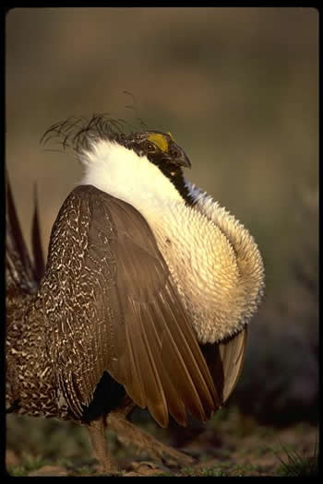
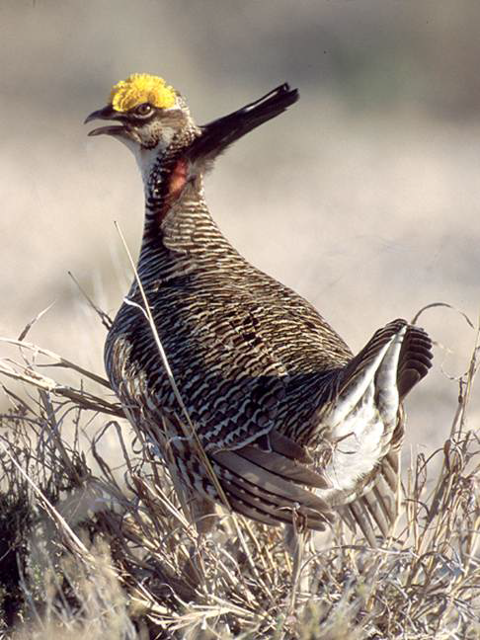
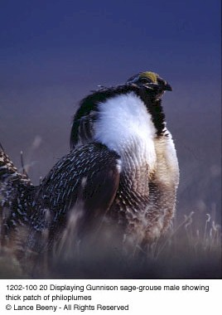
http://www.fws.gov/mountain-prairie/species/birds/sagegrouse/
Picture Credit: Larry Lamsa
Notes:
Some of the important impending USFWS listing decisions in Colorado: greater sage-grouse, Gunnison sage-grouse, and lesser prairie-chicken.

Slide 4

Endangered Species Act Basics
Petitioned
Warranted
Proposed
Candidate
Threatened/
Critical Habitat
Endangered/ Critical Habitat
Not Warranted
Final Listing, Withdrawal, or Extension
Final Listing, Withdrawal, or Extension
Notes:
The purpose of the ESA is to protect and recover imperiled species and the ecosystems upon which they depend. The ESA protects endangered and threatened species and their habitats by prohibiting the “take” of listed animals. Take is defined as “to harass, harm, pursue, hunt, shoot, wound, kill, trap, capture, or collect or attempt to engage in any such conduct.” Critical habitat includes geographic areas that contain the physical or biological features that are essential to the conservation of the species and that may need special management or protection. Under the ESA, species may be listed as either endangered or threatened. “Endangered” means a species is in danger of extinction throughout all or a significant portion of its range. “Threatened” means a species is likely to become endangered within the foreseeable future. The FWS also maintains a list of “candidate” species. These are species for which the FWS has enough information to warrant proposing them for listing but is precluded from doing so by higher listing priorities. While listing actions of higher priority go forward, the FWS works with States, Tribes, private landowners, private partners, and other Federal agencies to carry out conservation actions for these species to prevent further decline and possibly eliminate the need for listing. The Act requires that the Service takes one of three actions within one year of a proposed listing: (1) Finalize the proposed listing; (2) withdraw the proposed listing; or (3) extend the final determination by not more than 6 months, if there is substantial disagreement regarding the sufficiency or accuracy of the available data relevant to the determination, for the purposes of soliciting additional data.

Slide 5
Wildlife in the Forefront
Impending USFWS Listing Decisions and Critical Habitat Designations
Evaluation of State jurisdiction
Revisions of BLM management documents
Initiation of BLM regional mitigation planning
Increased activity of multi-stakeholder groups
Heightened public interest
Effective environmental groups
Notes:
Wildlife has moved to the forefront of the discussion regarding responsible development.

Slide 6
Improving ESA Implementation
USFWS ESA Listing Workplan FY13-FY18
Package name # | Common name | Scientific name | States or Territories within the Historical Range | Action ## | Date ### | Lead USFWS Region
Lesser prairie chicken | Prairie-chicken, lesser | Tympanuchus pallidicinctus | CO, KS, NM, OK, TX | PL | FY13 | R2
Gunnison sage-grouse | Sage-grouse, Gunnison | Centrocercus minimus | AZ, CO, NM, UT | PLPCH | FY13 | R6
Graham's and White River penstemon | Beardtongue, White River | Penstemon scariosus var. albifluvis | CO, UT | PLPCH | FY13 | R6
Graham's and White River penstemon | Graham's Penstemon (beardtongue) | Penstemon grahamii | CO, UT | PLPCH | FY13 | R6
Lesser prairie chicken | Prairie-chicken, lesser | Tympanuchus pallidicinctus | CO, KS, NM, OK, TX | PCH | FY13 | R2
New Mexico jumping mouse | Mouse, New Mexico meadow jumping | Zapus hudsonius luteus | AZ, CO, NM, | PLPCH | FY13 | R2
wolverine | Wolverine, North American | Gulo gulo luscus | CA, CO, ID, MT, OR, UT, WA, WY | PLPCH | FY13 | R6
yellow-billed cuckoo | Cuckoo, yellow-billed (Western U.S. DPS) | Coccyzus americanus | AZ, CA, CO, ID, MT, NM, NV, OR, TX, UT, WA, WY | PLPCH | FY13 | R8
Gunnison sage-grouse | Sage-grouse, Gunnison | Centrocercus minimus | AZ, CO, NM, UT | FLFCH | FY13 | R6
Lesser prairie chicken | Prairie-chicken, lesser | Tympanuchus pallidicinctus | CO, KS, NM, OK, TX | FL | FY13 | R2
Southwest Willow Flycatcher | Southwest Willow Flycatcher | Empidonax traillii extimus | AZ, CA, CO, NV, NM, TX, UT, MX | rFCH | FY13 | R2
Canada Lynx | Canada Lynx, New Mexico | Lynx canadensis | CO, ID, ME, MI, MN, MT, NH, NY, OR, UT, VT, WA, WI, WY | rPCH | FY13 | R6
Gunnison's prairie dog | Prairie dog, Gunnison’s (central and south-central CO, north-central NM SPR) | Cynomys gunnisoni | CO, MN | PLPCH | FY14 | R6
Rio Grande cutthroat | Trout, Rio Grande cutthroat | Oncorhynchus clarki virginalis | CO, NM | PLPCH | FY14 | R2
Notes:
In an effort to improve implementation of the Endangered Species Act (ESA), the U.S. Fish and Wildlife Service (Service) submitted to the U.S. District Court for the District of Columbia, a multi-year listing work plan that will enable the agency to systematically, over a period of six years, review and address the needs of more than 250 species listed on the 2010 Candidate Notice of Review, to determine if they should be added to the Federal Lists of Endangered and Threatened Wildlife and Plants.
As part of a court-approved settlement, the Service has committed to publish certain ESA listing actions – petition findings, listing determinations, critical habitat designations – in Fiscal Years 2013-2018. The agreement is intended to significantly reduce ESA-related litigation and allow the agency to focus its resources on the species most in need of ESA protection. Most of these actions included in the workplan are for candidate species—species that the Service had previously determined warrant a listing proposal but for which the Service have not yet been able to initiate the listing process. The ESA, and various court approved settlement agreements, require the Service to act on all these listing duties.
Includes 15 species that occur in Colorado. The table shown here is just a sample of these species. This work plan is available online.

Slide 7
Greater Sage-Grouse
Candidate
Proposed listing and critical habitat 2015
Final listing and critical habitat 2016
http://www.fws.gov/mountain-prairie/species/birds/sagegrouse/
http://www.fws.gov/nevada/videos/videos.html#sg

Slide 8
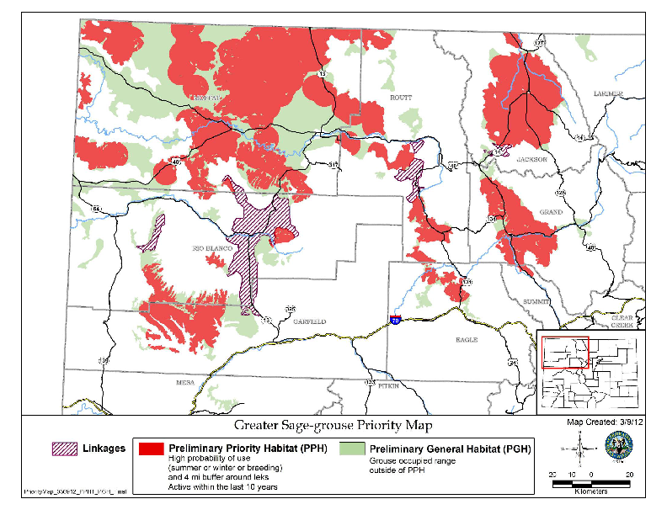
Notes:
BLM and Colorado Parks and Wildlife are adopting this map. Greater sage grouse range in Colorado is NW region of state.

Slide 9
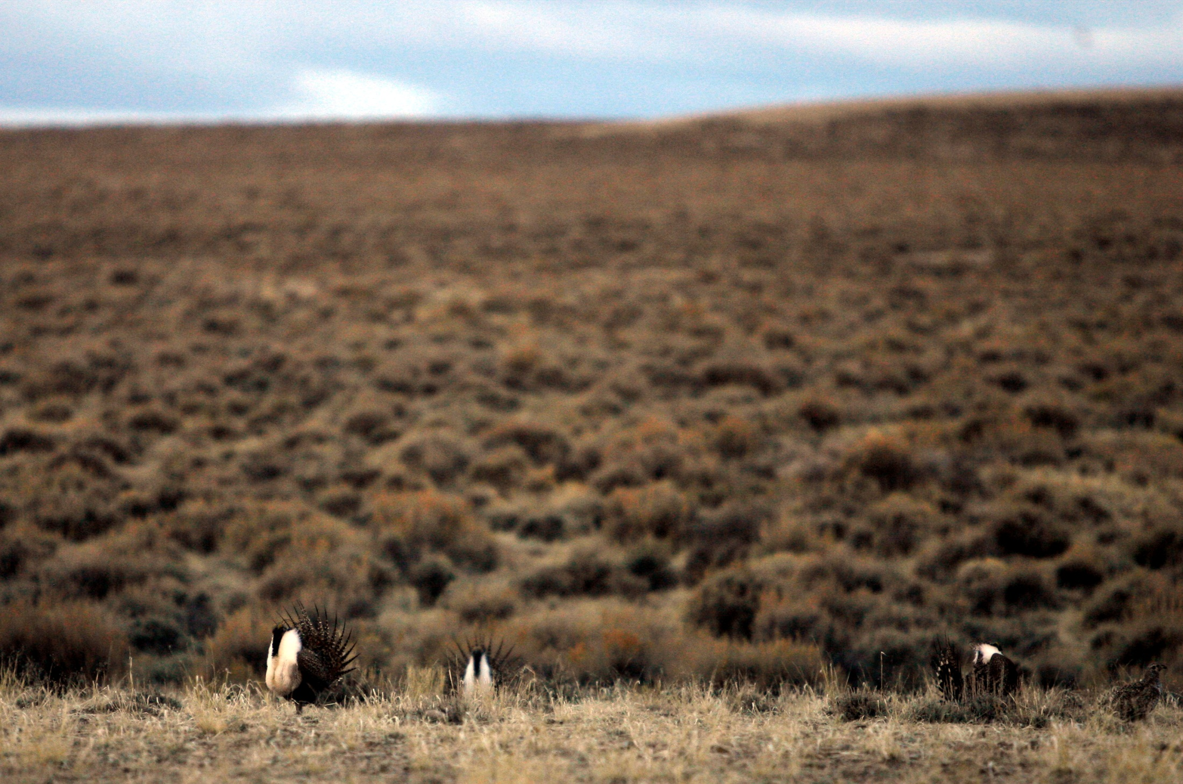
Taking Action
Greater Sage-Grouse
Bureau of Land Management
Colorado Department of Natural Resources
Colorado Oil and Gas Conservation Commission
Colorado Parks and Wildlife
Notes:
Many parties taking action to get out in front of a listing decision, either to try to influence the Service’s decision and preclude the need for listing, to get their ducks in a row for management of the species whether it’s listed or not, or to recover the species whether it’s listed or not. BLM is due to publish for public review in August the Northwest Colorado Resource Management Plan Amendment Environmental Impact Statement. DNR prepared the Colorado Package for the Service to describe what the state is doing to protect the species and aid the Service in their listing decision. COGCC requires oil and gas operators consult with Colorado Parks and Wildlife if development is proposed in Sensitive Wildlife Habitat.

Slide 10







Colorado Habitat Exchange
Greater Sage-Grouse
Notes:
COGA is participating in a multi-stakeholder group to develop the Colorado Habitat Exchange.

Slide 11
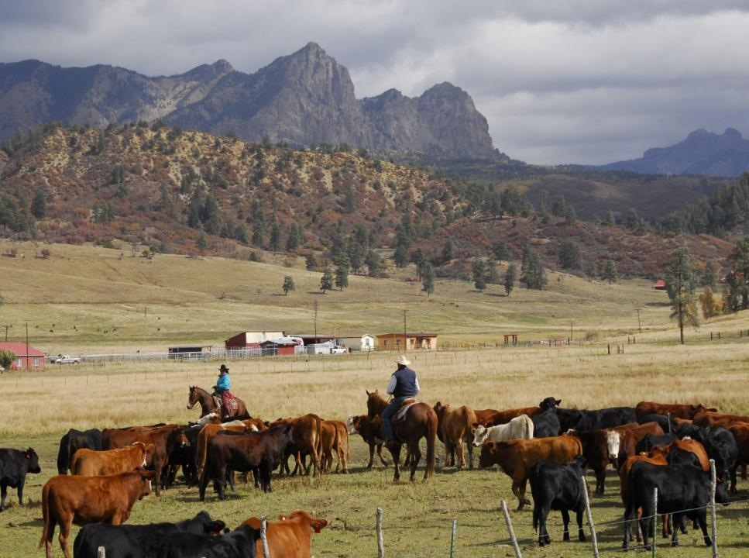

Colorado Habitat Exchange
Greater Sage-Grouse
Market-based conservation mechanism
Science-based: quantified & verified
Outcome-based
Improves certainty for project development
Transparent
Meets standards of key regulatory entities
W. Scott/Shutterstock.com
Notes:
The Colorado Habitat Exchange is a market-based conservation mechanism for mitigating greater sage-grouse and mule deer habitat impacts from energy and other types of development. In the near term, the Exchange will result in investments in habitat for these species, and over the long-term will create a scalable approach for capturing habitat value and achieving conservation goals for a broader array of species and ecosystem services. The vision for the future of the Exchange is to support the maintenance, restoration, and enhancement of Colorado’s natural resources.
Why is the Colorado Habitat Exchange initially focusing on habitat mitigation for greater sage-grouse and mule deer targeted to the energy sector?
Colorado’s identification of sensitive wildlife habitats along with mitigation plans for operations within those habitats and the clarified ability of BLM to employ “off-site” mitigation provide us with opportunities to build a prototype credit system. For example, if companies invest in the kinds of mitigation called for by either the CPW plans or through BLM’s permitting process, then those investments could streamline permitting for the immediate project and investment beyond the current requirements should represent a “credit” that can streamline permitting in other areas.
A logical starting point to begin building this framework is with the energy sector and wildlife habitat, as a function of their investment in the development of Partners for Western Conservation (PWC), which is already working with Colorado Parks and Wildlife and companies on mitigation projects. PWC is also connected to similar efforts elsewhere in the West (e.g., Cooperative Sagebrush Initiative, Willamette Partnership) to develop metrics for habitat evaluation (for impacts and for conservation measures) that could be valuable for this project. While the energy sector is a logical starting point, the program will be designed to accommodate a wide range of other investors including private companies, agencies, conservation investors, organizations and landowners.
Our initial focus is on greater sage-grouse for several reasons:
Environmental Need: The greater sage-grouse has declined drastically from its historic numbers; today’s numbers are less than ten percent of historic. The expansion of oil and natural gas facilities as well as other land use changes impact sage brush habitat, reducing the amount of viable habitat for the species. Protecting sage brush habitat for sage grouse will also support other species and ecosystem services.
Demand Drivers and Applicable Policies: The greater sage-grouse has been petitioned for listing under the Endangered Species Act. By 2015, the US Fish and Wildlife Service must decide whether the species is warranted for listing or not. No other species in the western US would have greater economic impact if listed. A federal listing would affect land use decisions in many sectors of the economy, especially energy and agriculture.
Opportunity: Several Western states and the Federal government are currently developing strategies for how to reduce the decline prior to the listing decision. The time is now to develop conservation solutions that halt this decline and push the species toward recovery, preferably so that there is no need to list the species.
The objective of the Colorado Habitat Exchange is to create a performance-based approach that enables net-positive outcomes for wildlife and improves the effectiveness and efficiency of conservation investments.
Some Key Principles of the Exchange:
Market-based to maximize the amount and value of conservation achieved per dollar invested;
Science-based, employing the best available science, including expert opinion, to determine the most appropriate conservation actions and quantification methods;
Achieves measureable net conservation benefits;
Improves certainty and efficiency for energy and other project developers;
Transparent and fair to all stakeholders;
Focused on meeting priority habitat and species conservation goals of the State;
Meets the standards and approval of key regulating entities, if and when regulatory approval is necessary (i.e. US Fish and Wildlife Service for species listed under the Endangered Species Act).

Slide 12
Problem: Net loss of habitat each year despite mitigation, public & private investment
Problem: Net loss of habitat each year despite mitigation, public & private investment
Habitat lost to development
Net loss
Functional-Acres
0
Private non-mitigation
Public land mgt
Farm Bill & regional programs
Mitigated through non-banking actions
Mitigated through banking
-500,000
Numeric values are rough estimates for illustration only
Source: Environmental Incentives, LLC
Notes:
The problem with traditional offsets is that there is a net loss of habitat each year (see yellow boxes), despite significant mitigation and public & private investment (see green and blue boxes).

Slide 13
Vision: Performance based investment for mitigation, public & private investment
Public land mgt
Net Gain
10,000,000
Vision: Performance based investment for mitigation, public & private investment
Private philanthropy
Farm Bill & regional programs
Mitigated through non-banking actions
Improvement Over Status Quo
Mitigated through banking
Functional-Acres
Habitat lost to development
0
Status Quo Net Loss
-300,000
Numeric values are rough estimates for illustration only
Source: Environmental Incentives, LLC
Notes:
The Colorado Habitat Exchange provides a performance-based mechanism for environmental impact mitigation and investment in conservation. The Exchange uses a standardized science-based conservation “credit” to quantify conservation benefits. Unlike most mitigation efforts, conservation credit trading systems incorporate both the quantity and quality of environmental impact and uplift. Establishing standardized conservation credits enables an understanding of environmental return on investment while reducing transaction costs and increasing certainty for credit buyers and sellers.

Slide 14
Lesser Prairie-Chicken
Proposed threatened
Final listing and critical habitat – originally September 2013 – extended to March 2014
http://www.youtube.com/watch?v=cXpeAmArbW8&feature=youtu.be
Picture Credit: Larry Lamsa
Notes:
Decision extended based on need to further review best available science.

Slide 15
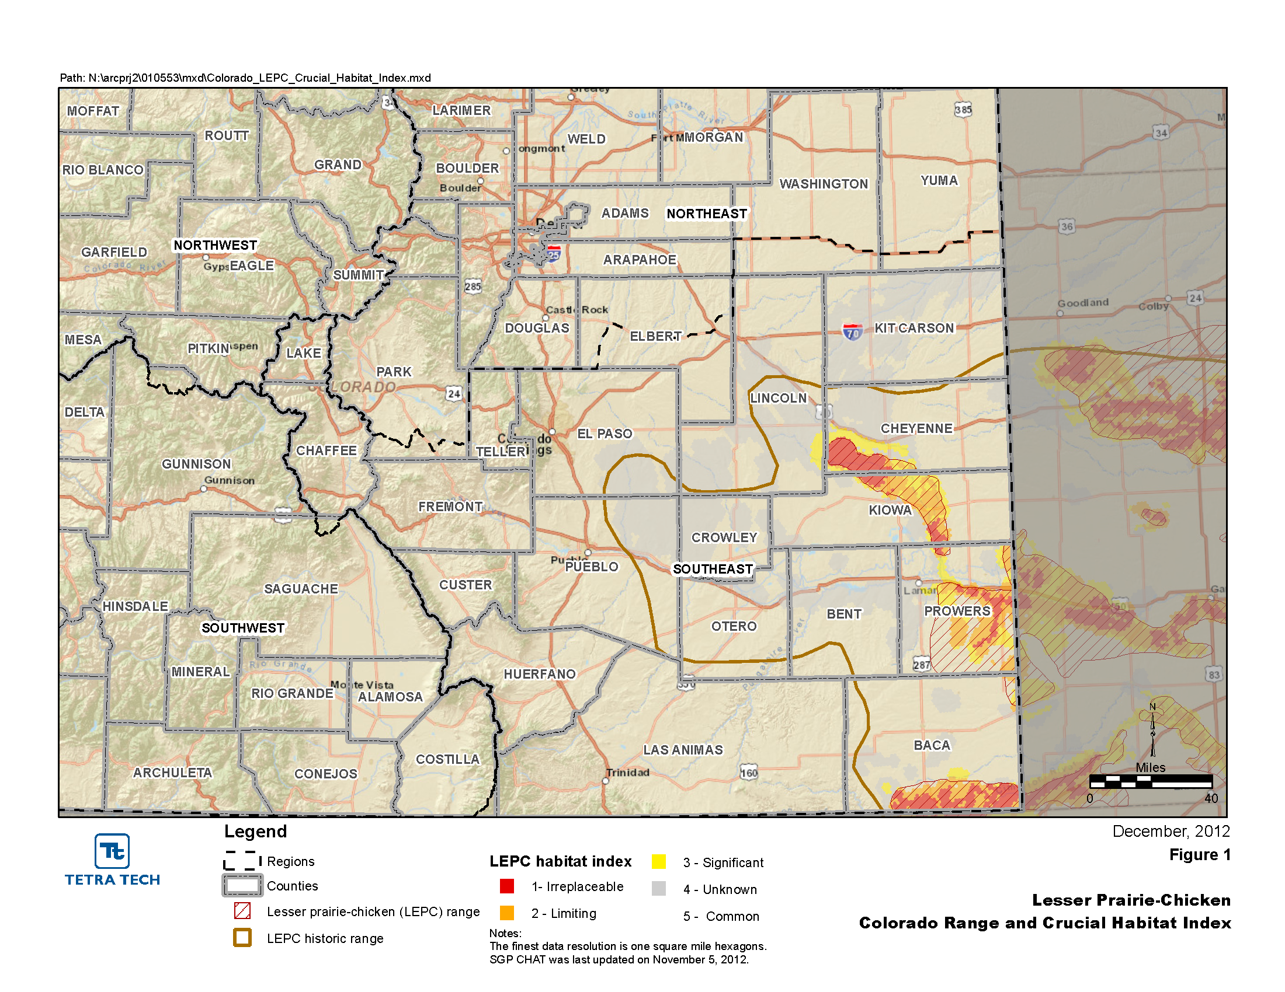
Notes:
Southern Great Plains Crucial Habitat Assessment Tool (CHAT). Lesser prairie chicken range in Colorado is SE region of state.

Slide 16
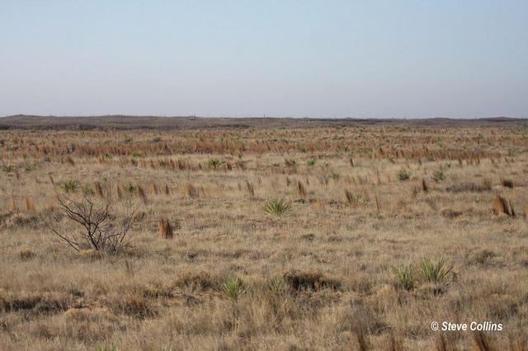
Taking Action
Lesser Prairie-Chicken
Colorado Oil and Gas Conservation Commission
Colorado Parks and Wildlife
Western Association of Fish and Wildlife Agencies
LEPC Habitat Exchange
Notes:
COGCC requires oil and gas operators consult with Colorado Parks and Wildlife if development is proposed in Sensitive Wildlife Habitat (SWH). COGCC/CPW is currently proposing a rulemaking to revise the SWH maps for this species to reflect the WAFWA plan. WAFWA’s 4th draft rangewide conservation plan is available online. Service hasn’t accepted the plan. A multi-stakeholder group is developing another mitigation program similar to the greater sage grouse habitat exchange.

Slide 17

Range-wide Conservation Plan
Lesser Prairie-Chicken
WAFWA Lesser Prairie Chicken Interstate Working Group:
Kansas Department of Wildlife, Parks, and Tourism
Oklahoma Department of Wildlife Conservation
Colorado Parks and Wildlife
Texas Parks and Wildlife Department
New Mexico Game, Fish and Parks
Candidate Conservation Agreement with Assurances (CCAA)
Proposed Special Rule 4(d)
Notes:
Is a range-wide conservation strategy that wildlife agencies from 5 states participated in developing. Includes a CCAA component, which would be an in lieu fee program with funding going to WAFWA to implement conservation projects. The Service also published a proposed special rule 4(d) that would cover activities conducted as part of a state agency-prepared conservation program. Comments were submitted requesting language change to state agency-approved conservation program, to recognize programs such as the Lesser prairie-chicken Habitat Exchange that is in development. COGA’s perspective is that they want as many suitable, viable options as possible for operators to choose from, which may include this plan as well as the habitat exchange.

Slide 18
Gunnison Sage-Grouse
Proposed endangered
Final listing and critical habitat – originally September 2013 – extended to March 2014
Notes:
Decision extended based on need for further review of best available science.

Slide 19
Notes:
Gunnison sage grouse range in Colorado is SW region of state.

Slide 20
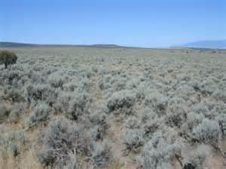
Taking Action
Gunnison Sage-Grouse
Colorado Oil and Gas Conservation Commission
Colorado Parks and Wildlife
Notes:
COGCC requires consultation with CPW in SWH. Currently proposed rulemaking to revise SWH maps for this species.

Slide 21

Regulatory Assurances?
Notes:
None of the efforts underway have been approved by the Service, which makes it difficult to know what the right strategies are for proactive actions at this point.

Slide 22
Land Management and Business Decisions in an Uncertain Future
Consult with state wildlife agency
Implement and document avoidance and minimization measures
Determine risk management strategy for conservation agreements
Notes:
During this period of uncertainty, consult with the State wildlife agency, implement avoidance and minimization measures, and document the heck out of it. Also weigh your company’s/client’s risk management strategy (i.e., put more resources up front to engage in a CCAA or wait until listing decision and prepare a Habitat Conservation Plan if necessary). The key difference between development of a CCAA and an HCP is the timing of the process, specifically before listing of a species in hopes of preventing federal listing versus after the listing has been completed.

